Slide 1
Digital Portfolio
STUDENT NAME : J. MOHAMMED RAHMAN
REGISTER NO : 222407870
NMID : 75A7A9506B3D178949C4B1ABAE3DCCCA
DEPARTMENT : B.Sc. COMPUTER SCIENCE WITH DATA SCIENCE
COLLEGE : TAGORE COLLEGE OF ARTS AND SCIENCE
UNIVERSITY : UNIVERSITY OF MADRAS
1
Notes:
1

Slide 2
PROJECT TITLE:
“Development of a Responsive Digital portfolio website using HTML,CSS, JavaScript”
2

Slide 3


AGENDA
Problem Statement
Project Overview
End Users
Tools and Technologies
Portfolio design and Layout
Features and Functionality
Results and Screenshots
Conclusion
Github Link
3
3/21/2024 Annual Review

Slide 4

PROBLEM STATEMENT
Explain the core challenge your portfolio solves, such as presenting skills, projects, and contact in a creatives and interactive way for academic and professional visibility
4

Slide 5

PROJECT OVERVIEW
The project is a modern multi-section portfolio website designed to showcase a person's professional profile, skills, projects, and contact information. It features an elegant, user-friendly interface with multiple sections including Home, About Me, Skills, Projects, and Contact, each accessible via a navigation menu. Interactive elements include typing effects on roles, animated skill bars, and a responsive layout for different devices.
5

Slide 6

WHO ARE THE END USERS?
Students , Job Seekers, Client and recruiters looking to assess qualification, Skills and Completed work
6

Slide 7

TOOLS AND TECHNIQUES
HTML, CSS, Bootstrap, JavaScript, Font Awesome for icons, Unplash / Random user for image, Mobile-first design principles
7

Slide 8
POTFOLIO DESIGN AND LAYOUT
Mention your use of HTML, CSS, Bootstrap 5, custom styles, and interactive navigation (no scrolling, tab/page transitions) as seen in your screenshots.
8

Slide 9
FEATURES AND FUNCTIONALITY
Section Switching
Animated Transition
Mobile responsiveness
Skill Progress bars
Image cards for projects
Contact form with Validation

Slide 10
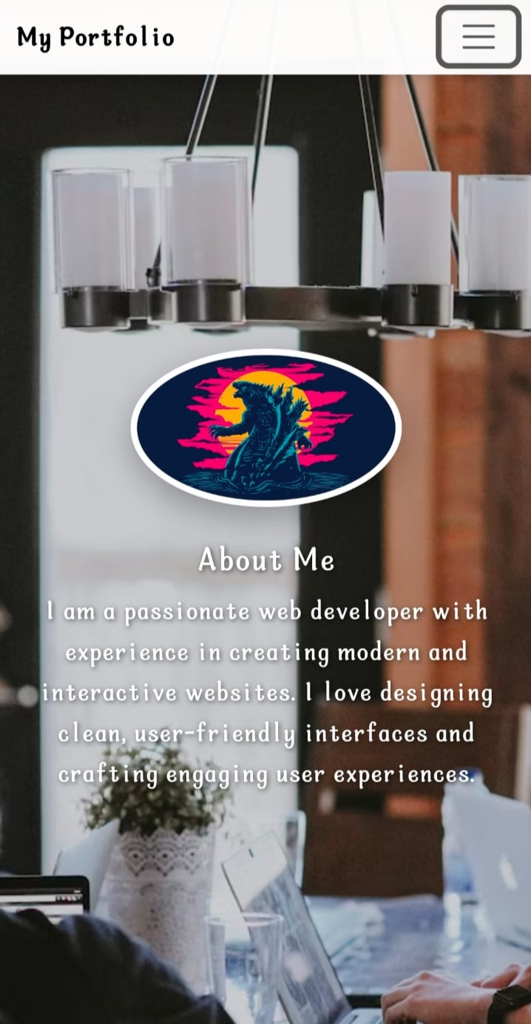
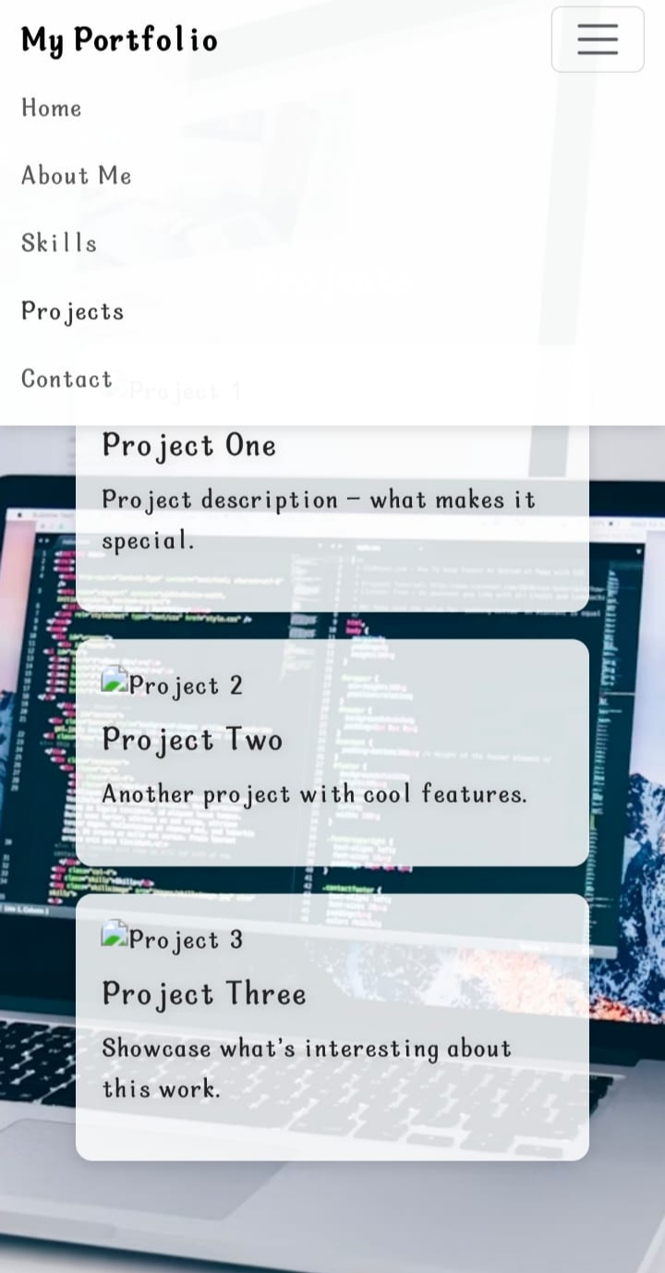
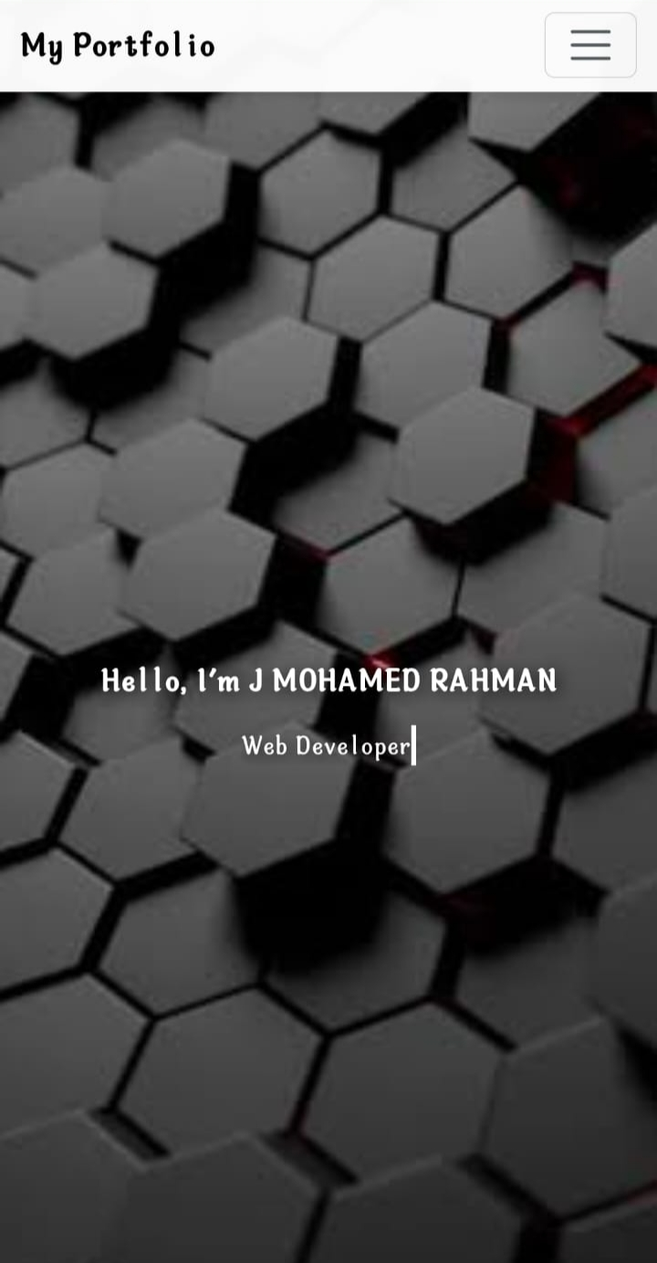
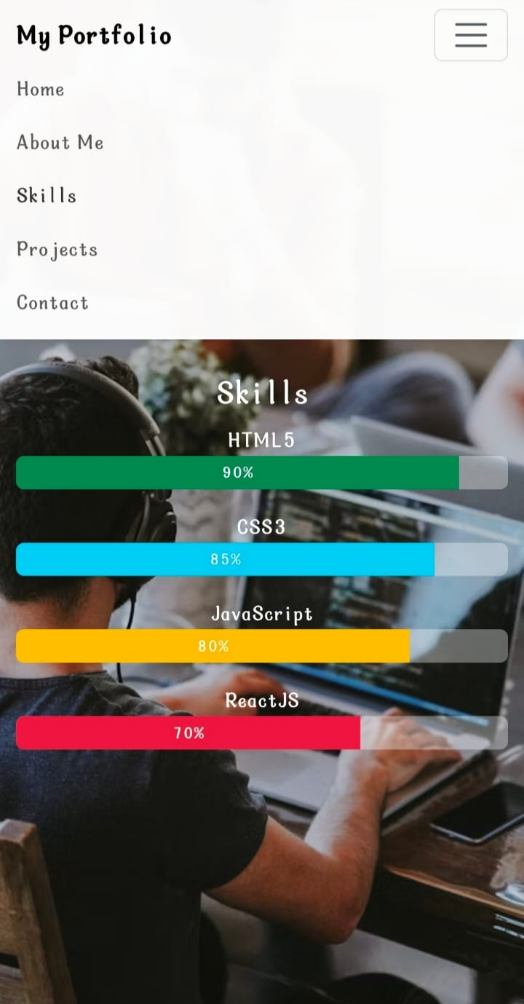
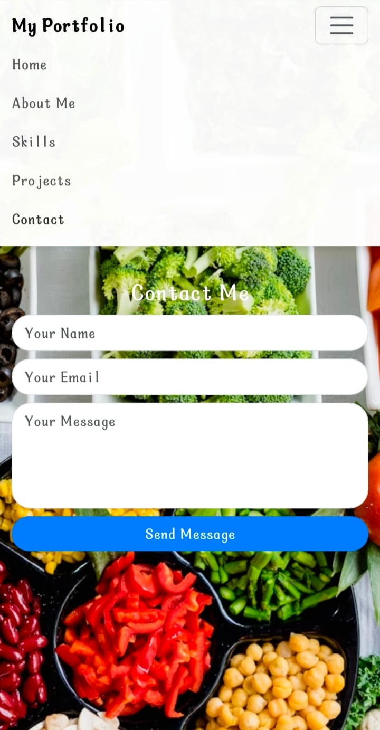

RESULTS AND SCREENSHOTS
3/21/2024 Annual Review
10

Slide 11
GitHub Link
https://github.com/namharrahman81-gif/NM-project-.git

Slide 12
CONCLUSION
The digital portfolio provides an innovative and
interactive way to present academic achievements and
technical skills. By using HTML, CSS, and JavaScript, the
portfolio enhances professional visibility, supports
career opportunities, and serves as a foundation for
future web development projects.
12

